Slide 1


Nasdaq: LAES
Investor
Presentation
December 2025

Slide 2
Forward-Looking Statementements
This communication expressly or implicitly contains certain forward-looking statements concerning SEALSQ Corp and its businesses. Forward-looking statements include statements regarding our business strategy, financial performance, results of operations, market data, events or developments that we expect or anticipates will occur in the future, as well as any other statements which are not historical facts. Although we believe that the expectations reflected in such forward-looking statements are reasonable, no assurance can be given that such expectations will prove to have been correct. These statements involve known and unknown risks and are based upon a number of assumptions and estimates which are inherently subject to significant uncertainties and contingencies, many of which are beyond our control. Actual results may differ materially from those expressed or implied by such forward-looking statements. Important factors that, in our view, could cause actual results to differ materially from those discussed in the forward-looking statements include SEALSQ's ability to continue beneficial transactions with material parties, including a limited number of significant customers; market demand and semiconductor industry conditions; and the risks discussed in SEALSQ's filings with the SEC. Risks and uncertainties are further described in reports filed by SEALSQ with the SEC.
SEALSQ Corp is providing this communication as of this date and does not undertake to update any forward-looking statements contained herein as a result of new information, future events or otherwise.
2

Slide 3

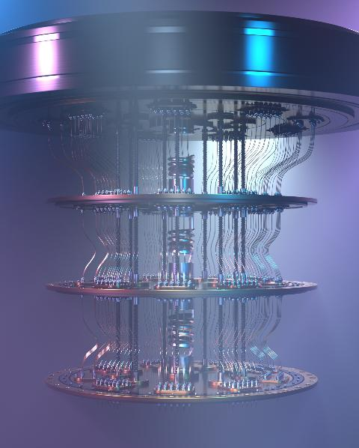


The Quantum Computing Threat: Are You Ready ?
Quantum computers progressing fast (Google, IBM…)
Threaten RSA/ECC encryption: Credit Cards, Passports, Bitcoin…
“Harvest Now – Decrypt Later”
IoT systems deployed today without PQC will be vulnerable tomorrow
NIST’s 2024 quantum-safe standards (ML-KEM, ML-DSA) drive new regulation & mandates
    Executive Order 14 144: Fed Agencies to adopt PQC & TLS 1.3 by 2030
    CISA building list of products that will need to be “PQC ready”

Slide 4




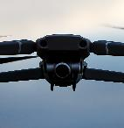










v
What We Do: End-to-End Quantum Proof Digital Security
We Design & Provide
To ensure
For
Authenticity
(Quantum resistant) Secure Chips
used to store, protect & encrypt…
…Compliant Certificates & Keys
that serve as device IDs,
And all the tools/services
to issue, provision & manage them from factory to field.
Connected Devices
People
Applications
Integrity
Confidentiality
Granting Compliance with most industry standards & public labels
3

Slide 5






Who We Are
Fabless Semiconductor Company
~200 employees, primarily focused on R&D
Catalog product, On-Demand Design & Supply, and Test & Perso
Leader In Quantum Resistant Solutions
Pioneer in Post-Quantum Cryptography (PQC) — Sampling today!
1.7+Bu shipped, Legacy of WISeKey S/C, INSIDE Secure, Atmel
Part Of WISeKey Cybersecurity Group
Swiss Cybersecurity Group with Global PKI & Trusted Services
Digital Identity, IoT-to-IoT Transaction, Satellite constellation
Differentiated Technology Portfolio
From IP to IC/Chips to Chiplet-based secure architectures Serving all verticals and high-stakes sectors
118 security-related patents.
Vision & Momentum
Enabling Hardware-based Security for a quantum-resilient future
Over $700M market cap (as of December 17, 2025)
Cash position $430M (as of November 18, 2025)
4

Slide 6
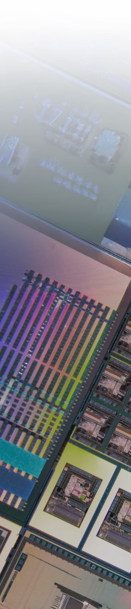







What We Sell
Secure Microcontrollers
Post Quantum Chips
Secure
ASIC
On Premise PKI infrastructure
Post Quantum Root of Trust
Custom chip design (ASIC)
Personalization & Test
PKI & Code Signing as-a -Service
6
Products
Services

Slide 7

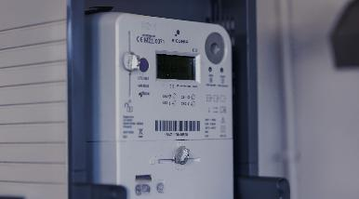
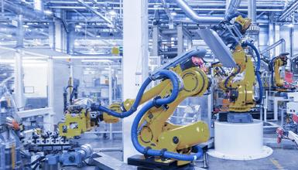




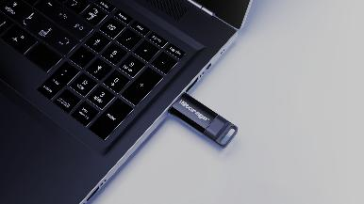

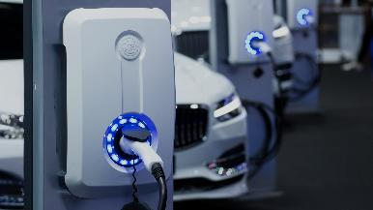
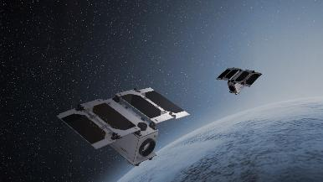






Typical Markets & Customers
IP PROTECTION
SMART GRID
INDUSTRY 4.0
HEALTHCARE
SECURE STORAGE
SMART HOME
AUTOMOTIVE
MILITARY & GOV.
7

Slide 8






Key Differentiators
Post-Quantum Technology
First to launch Quantum-resistant chips + post-quantum RoT & PKI
Security Expertise
Unique 25 years semiconductor expertise focusing on secure products & services
End-to-End
Only player offering full Security Stack from Root-of-Trust/PKI services to Hardware Secure Elements
Fully Accredited
PKI Certificates, Chips, Design process & Test Environments compliant with major Industry & Security standards
Customization/ASICS
Design AND supply of tailor-made chips to meet specific performance and security needs of large clients.
Personalization & Test
Test & Personalize chips with IDs and Data in a certified trusted environment
8

Slide 9
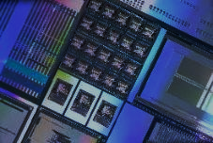


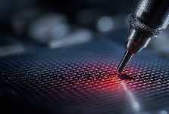



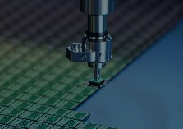
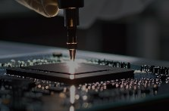
An End-to-End Value Proposition
IC’ALPS IPs
SEALSQ Security IPs
ASIC Design
Wafer Fabrication
SEALSQ Chip Design
Wafer Test
Personalization (INeS PKI)
Chip Packaging
Final Test
Factory
Field
QUANTIX
IC’ALPS
SEALSQ
Outsourced to foundry & packaging partner

Slide 10
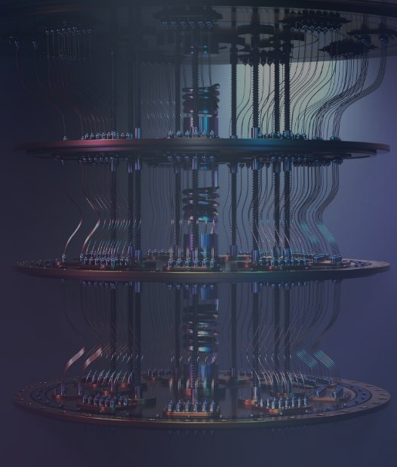
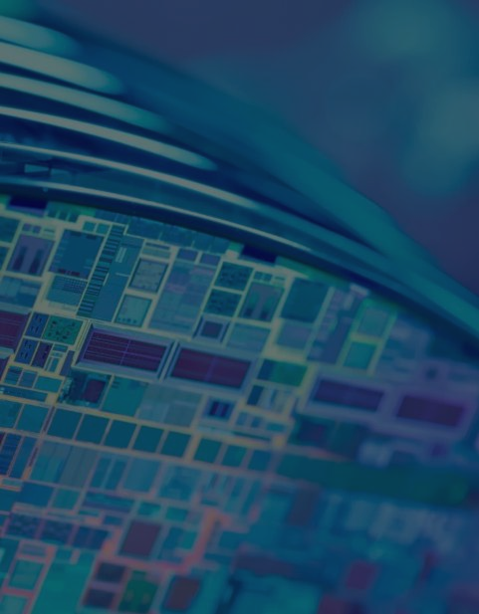

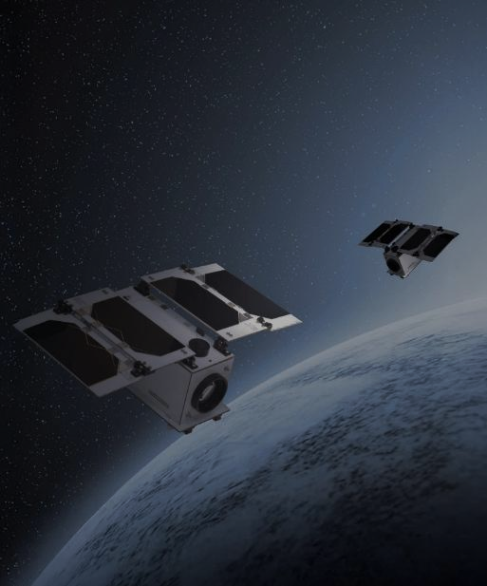
Major Strategic Initiatives
Post Quantum
Program
OSPT
Centers
Investment in Quantum & Tech Companies
Satellite
Connectivity
Custom & off the shelf quantum resistant semiconductors Commercial launch planned for 2026
High-performance chip design & customization centers in EU (signed/initiated in 25), UAE (signed), INDIA
$100M Fund to invest in Quantum & Tech
(4 investments completed)
Cost-effective IoT solutions for industrial applications
(recent launch in November)
10
10

Slide 11
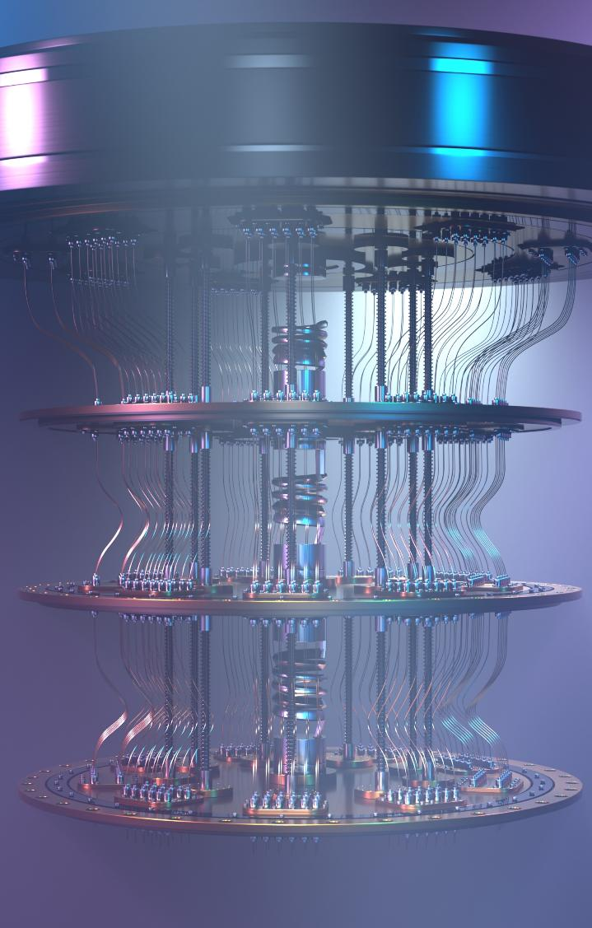




Highlight on SEALSQ’s Quantum Resistant Offer (QUASAR)
SEALSQ is pioneering the market with a Quantum Resistant suite offering the highest level of certifications
  Q1 2025: A Quantum Root-of-Trust
  Q2 2025: PKI services using NIST Post Quantum Cryptography
  Q4 2025: Quantum Resistant Semiconductors & security IP blocks to include in custom secure chips
Protection from logical & physical attacks
Platform Integrity (hardware & firmware )
Unique
& verifiable
System identity
Safeguard & manage cryptographic
keys & certificates
11

Slide 12

A Multi-Billion Unit Market
TPMs/ Secure elements/ HSMs/Secure ASICs embedding PQ algorithm
Quantum Resistant certificates (PKI)
2024 NIST Standards
2026 Mass Deployment
2030 ubiquitous PQ Chips/PKI
12
Source: Industry projections, NIST 2024 standards, xAI analysis (2025)

Slide 13

Dive-in: Test & Personalization Centers
Full-stack Semiconductor Provisioning & Test centers
  Trust Center for generation of digital identities (keys & certificates)
  Wafer Testing & Final Test
  Data Injection & Secure Personalization
Projects:
  Signed & starting 2025: EU (Murcia, Spain) - SEALSQ/ODINS/SETT Joint Venture (€40M)
  Signed: UAE (Abu-Dhabi) – SEALSQ/AJYAL Joint Venture ($100M)
  In progress: INDIA, US.
Government-Backed Investments
  €19.6 M from Spanish Government via SETT
  $100 M from UAE through AJYAL
Immediate Revenue for SEALSQ
  Professional Services charged from year 1
  IP Licensing model as recurring revenue
13

Slide 14

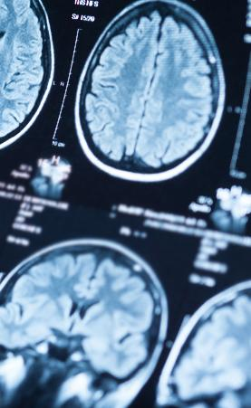
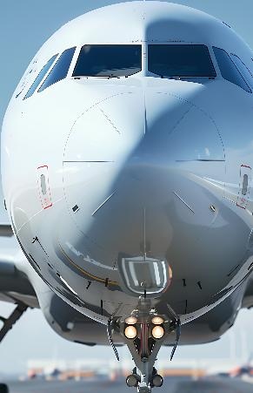




IC’ALPS Acquisition Strengthens ASIC Capabilities
90+ experts in 2 R&D centers focusing on ASIC/SoC Design & Supply
EU leader on demanding markets: medtech (incl. ultrasound), automotive & security
EU / French sovereignty for sensitive apps (Defense, Healthcare, Gov)
Listed as recommended design partner by major foundries (TSMC, Intel, Xfab, OSRAM, GF)
Covers all technologies: Analog / Digital / Mixed-signal down to 1,8 nm
Strong synergies: Customer portfolio / Supply Chain/ Secure ASICS / Security IPs
Security
Healthcare
Mil/Aero
Environmental
Automotive
Industry 4.0
IoT/AI
14

Slide 15
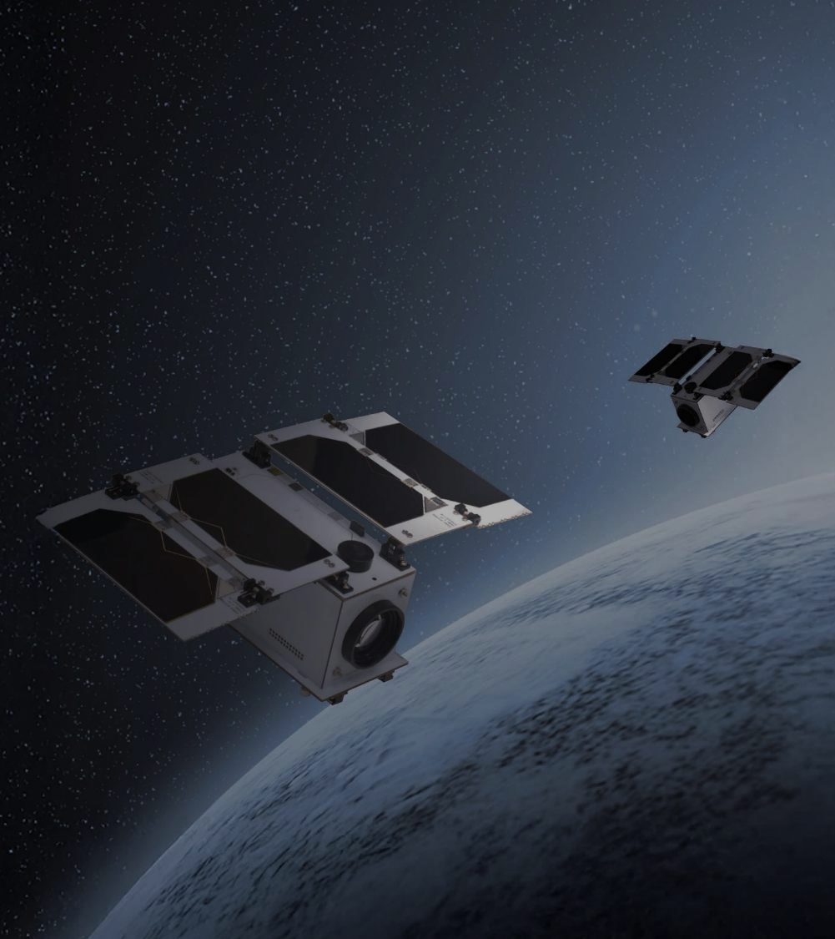
Dive-in: Secure Satellite Connectivity
Current Problem
Costly connectivity gap for a growing number of connected devices.
~80% Terrestrial connectivity gap
+25B IoT connected devices (2030)
Costly, Inefficient & Complex
Current solutions
Solution
Over 20 new next-generation satellites launched.
& More to come…
Each satellite will feature incremental advancements in post-quantum cryptography and secure communication technologies.
15

Slide 16
Financial Overview & Guidance
Strong revenue growth expected for FY 2026 driven by:
The full effect of newly launched PQC chips
Complete consolidation of IC’ALPS operations
Ramp-up of Quantix Edge revenues
Current Revenue & Projected Growth
$9.9M For 9M 2025 $5.1M generated in Q3 2025 alone 9M 2025 | $17.5M – 20.2M FY 2025 Guidance | +50% to +100% Growth Expected for FY 2026 F 2026 Guidance
Supported by
$200M Pipeline Potential Opportunities for 2026-2028 | $100M Quantum Investment Fund Established in 2025 | >$430M Cash Reserve as of November 15, 2025
16

Slide 17
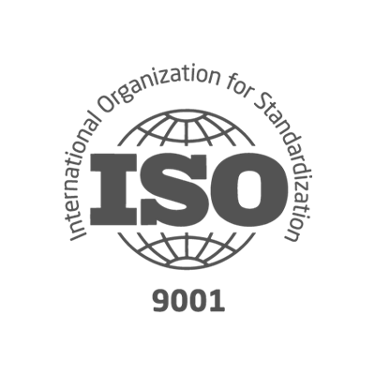
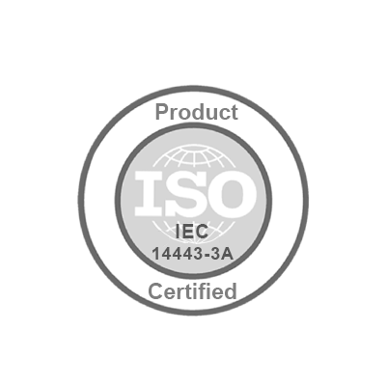




Key Figures
SEALSQ Corp.
Established | 1998 (acquired by WISeKey, parent company of SEALSQ in 2016 and reorganized in 2022)
Headquarters | France
Employees | ~175 total
 | ~75 R&D focused
Client base | 30+ countries
Patents | 118 security related
Certifications
Nasdaq listed | May 2023
Ticker symbol | LAES
Shares Outstanding
Ordinary Shares | 191.5 Million**
F shares * | 1,499,800
Stock price | $4.13/share
Market cap | $739 million
* In terms of dividend rights, 1 F share is equivalent to 5 Ordinary shares ** Data as of Dec 17, 2025
SEALSQ designs, produces and sells
Semiconductors, PKI Services and Post-Quantum technology products
5

Slide 18
Contact Us
Investor Relations (US)
The Equity Group Inc.
Lena Cati
Tel: +1 212 836-9611
lcati@theequitygroup.com
SEALSQ Corp.
Carlos Moreira
Chairman & CEO
info@sealsq.com

