Slide 1



Nasdaq: LAES
Investor
Presentation
March 2026

Slide 2

Forward-Looking Statementements
This communication expressly or implicitly contains certain forward-looking statements concerning SEALSQ Corp and its businesses. Forward-looking statements include statements regarding our business strategy, financial performance, results of operations, market data, events or developments that we expect or anticipates will occur in the future, as well as any other statements which are not historical facts. Although we believe that the expectations reflected in such forward-looking statements are reasonable, no assurance can be given that such expectations will prove to have been correct. These statements involve known and unknown risks and are based upon a number of assumptions and estimates which are inherently subject to significant uncertainties and contingencies, many of which are beyond our control. Actual results may differ materially from those expressed or implied by such forward-looking statements. Important factors that, in our view, could cause actual results to differ materially from those discussed in the forward-looking statements include SEALSQ's ability to continue beneficial transactions with material parties, including a limited number of significant customers; market demand and semiconductor industry conditions; and the risks discussed in SEALSQ's filings with the SEC. Risks and uncertainties are further described in reports filed by SEALSQ with the SEC.
SEALSQ Corp is providing this communication as of this date and does not undertake to update any forward-looking statements contained herein as a result of new information, future events or otherwise.
2

Slide 3
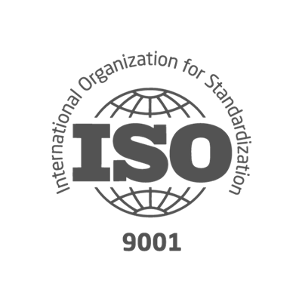
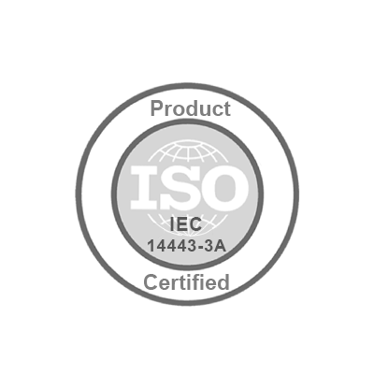





Key Figures
SEALSQ Corp.
Established | 1998 (acquired by WISeKey, parent company of SEALSQ in 2016 and reorganized in 2022)
Headquarters | Switzerland
Employees | ~200 total
 | ~120 R&D focused
Client base | 30+ countries
Patents | 118 security related
Certifications
Nasdaq listed | May 2023
Ticker symbol | LAES
Shares Outstanding
Ordinary Shares | 192 Million**
F shares * | 1.5 M
Stock price | $4.2/share
Market cap | $800 Million**
* In terms of dividend rights, 1 F share is equivalent to 5 Ordinary shares ** Data as of March 4, 2026
SEALSQ designs, produces and sells
Semiconductors, PKI Services and Post-Quantum technology products
5

Slide 4




Investment Thesis
Why SEALSQ now — the convergence of regulatory mandate, quantum threat, and proven technology
Urgent Market Need
Regulatory Tailwinds
Quantum computers (Google Willow, IBM Nighthawk) threaten all current public-key encryption (RSA, ECC). 'Harvest Now – Decrypt Later' is already happening.
NIST 2024 quantum-safe standards (ML-KEM, ML-DSA) enforced by CNSA 2.0 & EO 14144. Migration mandate: Jan 2027 → Dec 2031 across all connected categories.
First-Mover Advantage
Strong Financial Momentum
SEALSQ is the only end-to-end provider: quantum-resistant chips + PKI + Root-of-Trust + personalization. 1.7B+ chips shipped. 118 security patents.
$18M FY2025 revenue. Q1 2026 +100% YoY. FY2026 guidance: +50% to +100% growth. $425M+ cash. $200M pipeline. $100M quantum investment fund.
SEALSQ Corp. | Nasdaq: LAES | March 2026 — Confidential Investor Presentation
sealsq.com

Slide 5



The Quantum Computing Threat
A fundamental paradigm shift in cybersecurity is underway — and regulation is accelerating the response
Quantum Acceleration
Encryption at Risk
Harvest Now, Decrypt Later
Google Willow, IBM Nighthawk and other quantum systems are advancing rapidly, with exponential gains in qubit fidelity and error correction.
RSA and ECC — the backbone of credit cards, passports, TLS and Bitcoin — will be broken by sufficiently powerful quantum computers.
Adversaries are harvesting encrypted data today to decrypt once quantum capability is reached. Long-lived IoT deployments are especially exposed.
REGULATORY MANDATE — CNSA 2.0 & EO 14144
2024
Jan 2026
Jan 2027
2028-30
Dec 2031
NIST publishes ML-KEM
& ML-DSA standards
CISA releases full
scope product list
PQC migration
mandates begin
Quantum-safe
deployment ramp
Migration deadline
for all categories

Slide 6




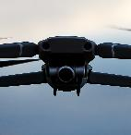





What We Do: Sovereign End-to-End Quantum Proof Digital Security
We Design & Provide
To ensure
For
Authenticity
(Quantum resistant) Secure Chips
used to store, protect & encrypt…
…Compliant Certificates & Keys
that serve as device IDs,
And all the tools/services
to issue, provision & manage them from factory to field.
Connected Devices
People
Applications
Integrity
Confidentiality
Granting Compliance with most industry standards & public labels

Slide 7






Who We Are
Fabless Semiconductor Company
~200 employees, primarily focused on R&D
Catalog product, On-Demand Design & Supply, and Test & Perso
Leader In Quantum Resistant Solutions
Pioneer in Post-Quantum Cryptography (PQC) — Sampling today!
1.7+Bu shipped, Legacy of WISeKey S/C, INSIDE Secure, Atmel
Part Of WISeKey Cybersecurity Group
Swiss Cybersecurity Group with Global PKI & Trusted Services
Digital Identity, IoT-to-IoT Transaction, Satellite constellation
Differentiated Technology Portfolio
From IP to IC/Chips to Chiplet-based secure architectures Serving all verticals and high-stakes sectors
118 security-related patents.
Vision & Momentum
Enabling Hardware-based Security for a quantum-resilient future
Cash position $425M (as of Dec 31, 2025)
Over $800M market cap (as of Jan 12, 2026)
4

Slide 8
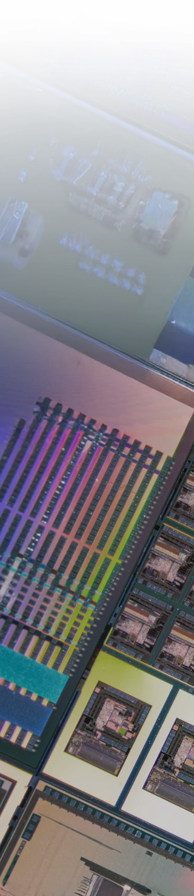







What We Sell
Secure Microcontrollers
Post Quantum Chips
Secure
ASIC
On Premise PKI infrastructure
Post Quantum Root of Trust
Custom chip design (ASIC)
Personalization & Test
PKI & Code Signing as-a -Service
6
Products
Services

Slide 9

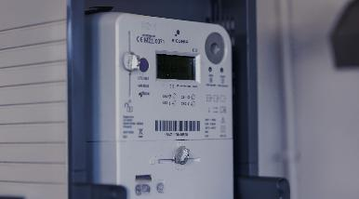
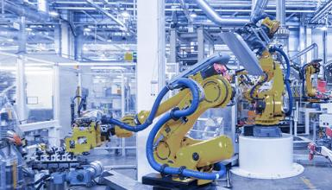




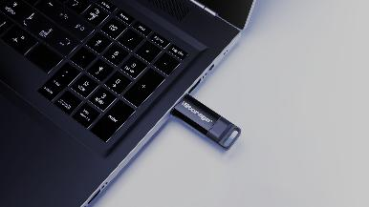

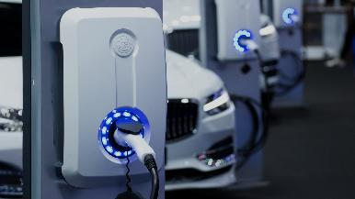
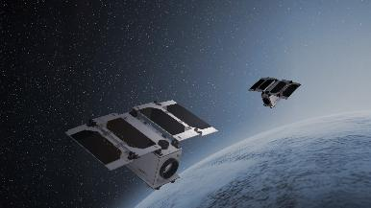






Typical Markets & Customers
IP PROTECTION
SMART GRID
INDUSTRY 4.0
HEALTHCARE
SECURE STORAGE
SMART HOME
AUTOMOTIVE
MILITARY & GOV.

Slide 10






Key Differentiators
Post-Quantum Pioneer
First to launch Quantum-resistant chips + post-quantum RoT & PKI
Security Expertise
Unique 25 years semiconductor expertise focusing on secure products & services
End-to-End Stack
Only player offering full Security Stack from Root-of-Trust/PKI services to Hardware Secure Elements
Fully Accredited
PKI Certificates, Chips, Design process & Test Environments compliant with major Industry & Security standards
Customization/ASICS
Design AND supply of tailor-made chips to meet specific performance and security needs of large clients.
Personalization & Test
Test & Personalize chips with IDs and Data in a certified trusted environment

Slide 11

The Quantum Highway
A strategic journey from today's silicon security to tomorrow's full quantum-native architecture
Quantum Native
2027+
Scale-Up
H2 2026
· Full PQC migration wave
· Regulation-driven demand
· Quantum hardware JVs
· Sovereign AI security
Acceleration
Q1–Q2 2026
· Qvault-409 IoT
· US OSPT center
· Quantix Edge ramp
· $200M pipeline exec
PQC Transition
2025
· Qvault-TPM launch
· IC'ALPS full integration
· EeroQ investment
· +100% Q1 revenue
· QS7001 PQC launch
· QUASAR suite begins
· IC'ALPS acquisition
· OSPT centers signed
Foundation
2023-2024
· Legacy chips
· LAES IPO
· Classical PKI
· WISeKey ecosystem

Slide 12




Major Strategic Initiatives
Four pillars reinforcing SEALSQ's position as the quantum security leader
Post-Quantum Program (QUASAR)
OSPT Test & Personalization Centers
· QS7001 Semiconductor Platform — Launched Q4 2025
· Spain (Murcia): SEALSQ/ODINS/SETT JV — €40M, €19.6M govt-backed
· Qvault-TPM (PC/Mobile) — Q2 2026
· India: SEALKAYNESQ JV — binding agreement signed
· Qvault-409 IoT — Q4 2026
· US center: In progress
· US-based Quantum Root-of-Trust & PKI live
· IP licensing + professional services from year 1
$100M Quantum Investment Fund
Secure Satellite Connectivity
· EeroQ (USA) — Superfluid Helium Qbit (2 rounds)
· 20+ next-gen satellites launched
· ColibriTD (France) — Quantum optimization, IBM Qiskit
· Addresses ~80% terrestrial connectivity gap
· Quobly (France) — Silicon Qbit tech (in discussion)
· 25B+ IoT devices by 2030 — growing market
· 5 investments completed; vertical stack integration
· PQC integrated into each satellite iteration

Slide 13






SEALSQ’s Quantum Ecosystem
Quantum-Resistant
Semiconductors
Test & Personalization
Centers (OSPT)
$100M Quantum
Investment Fund
SEALSQ Corp.
Post-Quantum
PKI & Certificates
Secure Satellite
Connectivity

Slide 14




From Root-of-Trust to QuBit
Partnerships & Investments in quantum companies to create secure semiconductor-based architectures for quantum computing.
France (Q2 2025) Minority investment in ColibriTD
Solver using quantum computing power for industrial applications / featured in IBM Quiskit
France (Q4 2025) Technical partnership and MoU for strategic investment in Quobly
Silicon based Qbit technology
USA (Q4 2025 & Q1 2026) Strategic investments in EeroQ
Superfluid Helium QuBit Technology

Slide 15
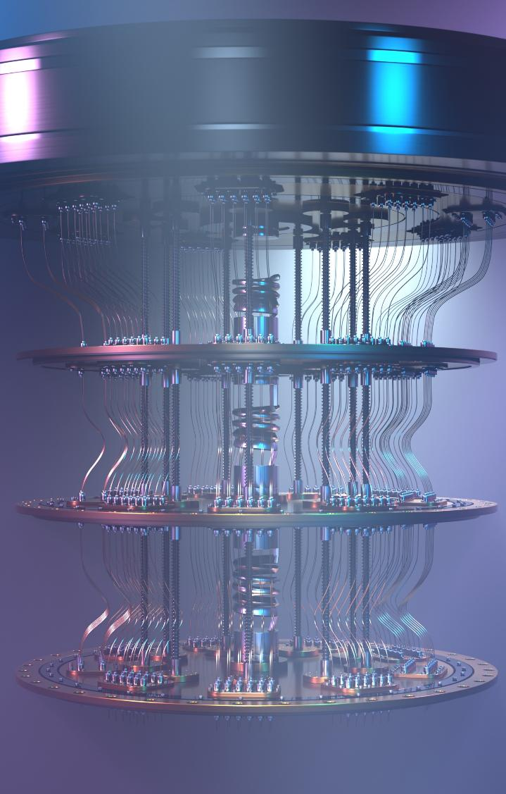




Highlight on SEALSQ’s Quantum Resistant Offer (QUASAR)
SEALSQ is pioneering the market with a Quantum Resistant suite offering the highest level of certifications
  2025: US based Quantum Root-of-Trust & PKI services using NIST Post Quantum Cryptography
  2025: First Quantum Resistant Semiconductor Platform (QS7001) & Security IP blocks to include in custom secure chips
  Q2 2026: First Quantum Resistant TPM chip (PC, Mobile)
  Q4 2026: Quantum Resistant secure chip for IoT (Qvault 409)
Protection from logical & physical attacks
Platform Integrity (hardware & firmware )
Unique
& verifiable
System identity
Safeguard & manage cryptographic
keys & certificates
11

Slide 16

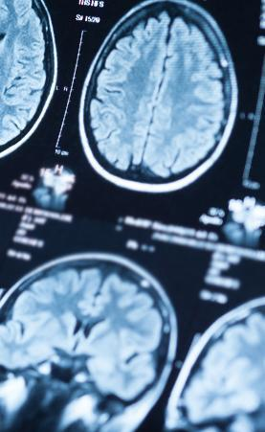
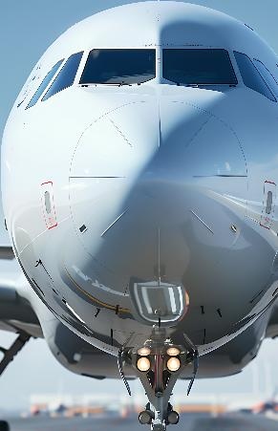




IC’ALPS Acquisition Strengthens ASIC Capabilities
90+ experts in 2 R&D centers focusing on ASIC/SoC Design & Supply
EU leader on demanding markets: medtech (incl. ultrasound), automotive & security
EU / French sovereignty for sensitive apps (Defense, Healthcare, Gov)
Listed as recommended design partner by major foundries (TSMC, Intel, Xfab, OSRAM, GF)
Covers all technologies: Analog / Digital / Mixed-signal down to 1,8 nm
Strong synergies: Customer portfolio / Supply Chain/ Secure ASICS / Security IPs
Security
Healthcare
Mil/Aero
Environmental
Automotive
Industry 4.0
IoT/AI
14

Slide 17
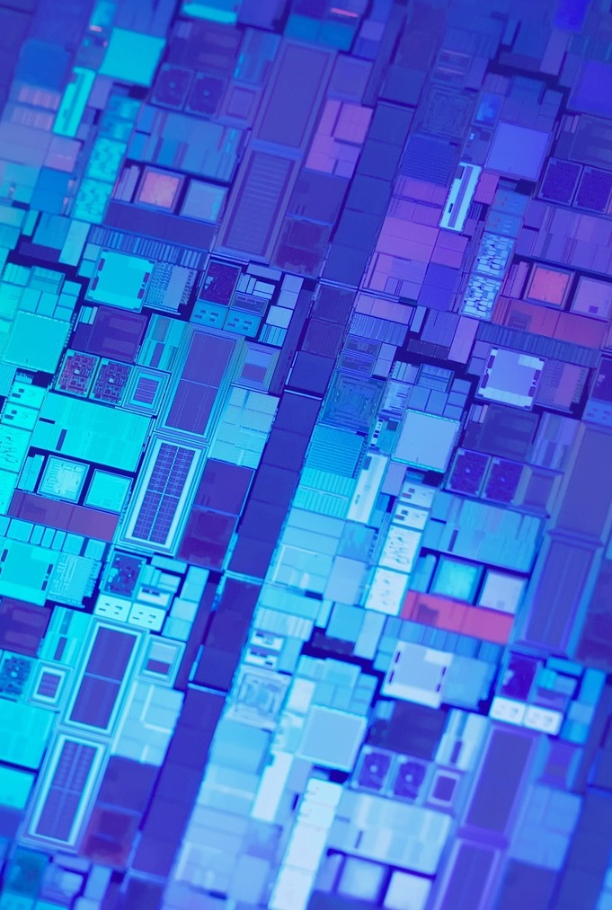
Test & Personalization Centers
Full-stack Semiconductor Provisioning & Test centers
  Trust Center for generation of digital identities (keys & certificates)
  Wafer Testing & Final Test
  Data Injection & Secure Personalization
Projects:
  Signed & starting 2025: EU (Murcia, Spain) - SEALSQ/ODINS/SETT Joint Venture (€40M)
  Binding agreement to establish a joint venture (JV) dubbed SEALKAYNESQ in India.
  In progress: US.
Government-Backed Investments
  €19.6 M from Spanish Government via SETT
Immediate Revenue for SEALSQ
  Professional Services charged from year 1
  IP Licensing model as recurring revenue
13

Slide 18
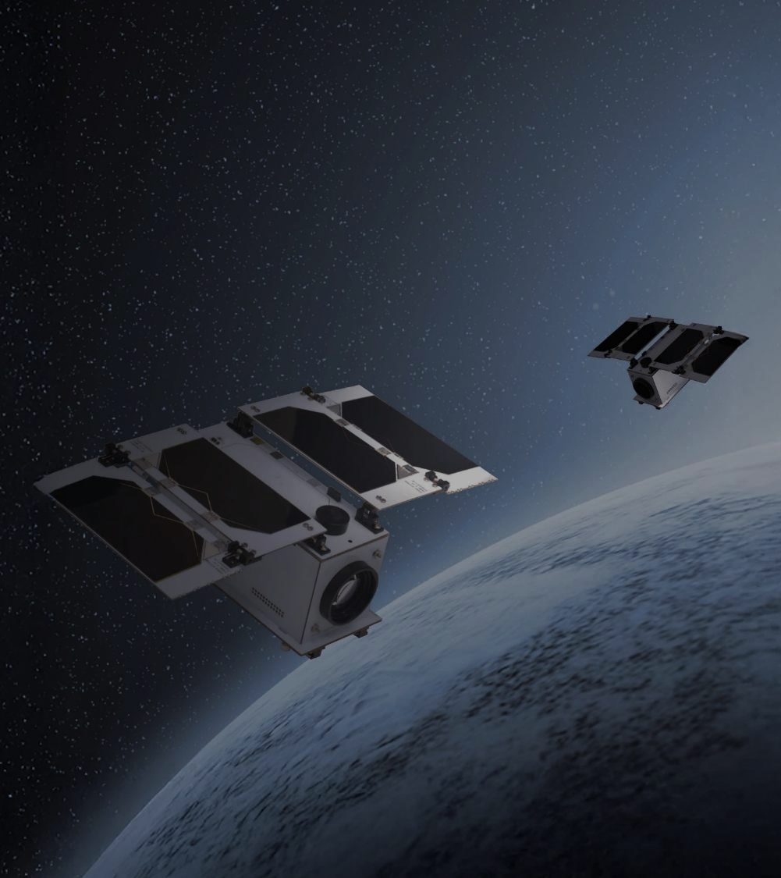
Dive-in: Secure Satellite Connectivity
Current Problem
Costly connectivity gap for a growing number of connected devices.
~80% Terrestrial connectivity gap
+25B IoT connected devices (2030)
Costly, Inefficient & Complex
Current solutions
Solution
Over 20 new next-generation satellites launched.
& More to come…
Each satellite will feature incremental advancements in post-quantum cryptography and secure communication technologies.
15

Slide 19
Financial Overview & Guidance
Strong revenue growth expected for FY 2026 driven by:
The full effect of newly launched PQC chips
Complete consolidation of IC’ALPS operations
Ramp-up of Quantix Edge revenues
Current Revenue & Projected Growth
$18M FY 2025 Preliminary Unaudited 9M 2025 | $4M+ Q1 2026 +100% vs Q1 2025 | +50% to +100% Growth Expected for FY 2026 F 2026 Guidance
Supported by
$200M Pipeline Potential Opportunities for 2026-2028 | $100M Quantum Investment Fund Established in 2025 | >$425M Cash Reserve as of December 31, 2025
16

Slide 20
Key Figures
SEALSQ Corp.
Established | 1998 (acquired by WISeKey, parent company of SEALSQ in 2016 and reorganized in 2022)
Headquarters | Switzerland
Employees | ~200 total
 | ~120 R&D focused
Client base | 30+ countries
Patents | 118 security related
Certifications
Nasdaq listed | May 2023
Ticker symbol | LAES
Shares Outstanding
Ordinary Shares | 192 Million**
F shares * | 1.5 M
Stock price | $4.2/share
Market cap | $800 Million**
* In terms of dividend rights, 1 F share is equivalent to 5 Ordinary shares ** Data as of March 4, 2026
SEALSQ designs, produces and sells
Semiconductors, PKI Services and Post-Quantum technology products
5

Slide 21
Contact Us
Investor Relations (US)
The Equity Group Inc.
Lena Cati
Tel: +1 212 836-9611
lcati@theequitygroup.com
SEALSQ Corp.
Carlos Moreira
Chairman & CEO
info@sealsq.com

