Slide 1


Investors
Presentation
August 2025

Slide 2

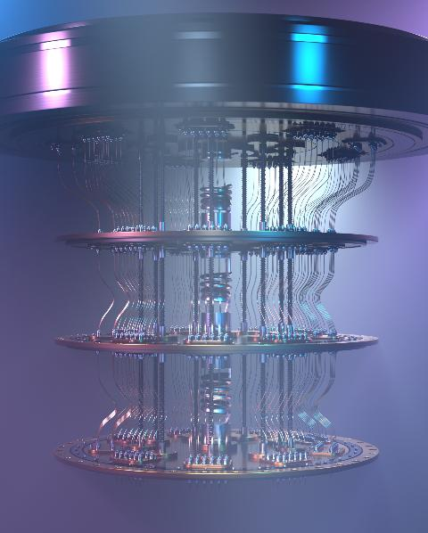


The Quantum Computing Threat: Are you ready ?
Quantum computers progressing fast (Google, IBM…)
Threaten RSA/ECC encryption: Credit Cards, Passports, Bitcoin…
“Harvest Now – Decrypt Later”
IoT systems deployed today without PQC will be vulnerable tomorrow
NIST’s 2024 quantum-safe standards (ML-KEM, ML-DSA) drive new regulation & mandates
    Executive Order 14 144: Fed Agencies to adopt PQC & TLS 1.3 by 2030
    CISA will list products to be “PQC ready” by Dec 2025

Slide 3




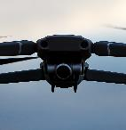










v
What we do: End-to-End Quantum Proof Digital Security
We Design & Provide
To ensure
For
Authenticity
(Quantum resistant) Secure Chips
used to store, protect & encrypt…
…Compliant Certificates & Keys
that serve as device IDs,
And all the tools/services
to issue, provision & manage them from factory to field.
Connected Devices
People
Applications
Integrity
Confidentiality
Granting Compliance with most industry standards & public labels
3

Slide 4






Who we are
Fabless Semiconductor Company
~200 employees, primarily focused on R&D
Catalog product, On-Demand Design & Supply, and Test & Perso
Leader In Quantum Resistant Solutions
Pioneer in Post-Quantum Cryptography (PQC) — Sampling today!
1.7+Bu shipped, Legacy of WISeKey S/C, INSIDE Secure, Atmel
Part Of Wisekey Cybersecurity Group
Swiss Cybersecurity Group with Global PKI & Trusted Services
Digital Identity, IoT-to-IoT Transaction, Satellite constellation
Differentiated Technology Portfolio
From IP to IC/Chips to Chiplet-based secure architectures Serving all verticals and high-stakes sectors
118 security-related patents.
Vision & Momentum
Enabling Hardware-based Security for a quantum-resilient future
~$450m market cap (*), Cash position $120m (*)
(*) NASDAQ (LAES) As of June 30, 2025
4

Slide 5
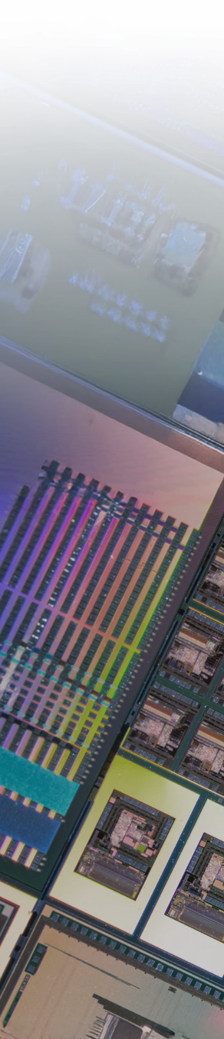







What we sell
Secure Microcontrollers
Post Quantum Chips
Secure ASIC
On Premise PKI infrastructure
Post Quantum Root of Trust
PKI & Code Signing as-a -Service
Custom chip design (ASIC)
Personalization & Test
6
Products
Services

Slide 6

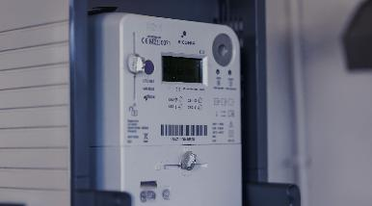





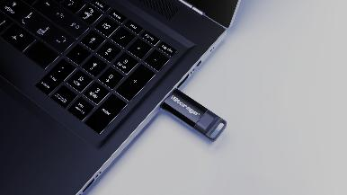

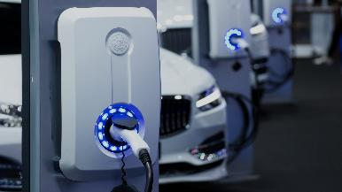
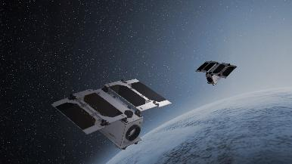






Typical Markets & Customers
IP PROTECTION
SMART GRID
INDUSTRY 4.0
HEALTHCARE
SECURE STORAGE
SMART HOME
AUTOMOTIVE
MILITARY & GOV.
7

Slide 7






Key Differentiators
Post-Quantum Technology
First to launch Quantum-resistant chips + post-quantum RoT & PKI
Security Expertise
Unique 25 years semiconductor expertise focusing on secure products & services
End-to-End
Only player offering full Security Stack from Root-of-Trust/PKI services to Hardware Secure Elements
Fully Accredited
PKI Certificates, Chips, Design process & Test Environments compliant with major Industry & Security standards
Customization/ASICS
Design AND supply of tailor-made chips to meet specific performance and security needs of large clients.
Personalization & Test
Test & Personalize chips with IDs and Data in a certified trusted environment
8

Slide 8
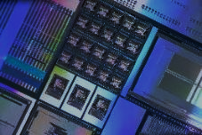


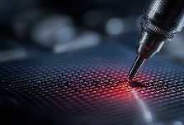



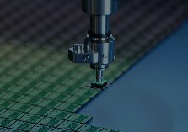
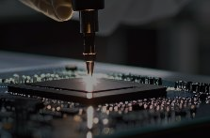
An End-to-End Value proposition
IC’ALPS IPs
SEALSQ Security IPs
ASIC Design
Wafer Fabrication
SEALSQ Chip Design
Wafer Test
Personalization (INeS PKI)
Chip Packaging
Final Test
Factory
Field
QUANTIX
IC’ALPS
SEALSQ
Outsourced to foundry & packaging partner

Slide 9
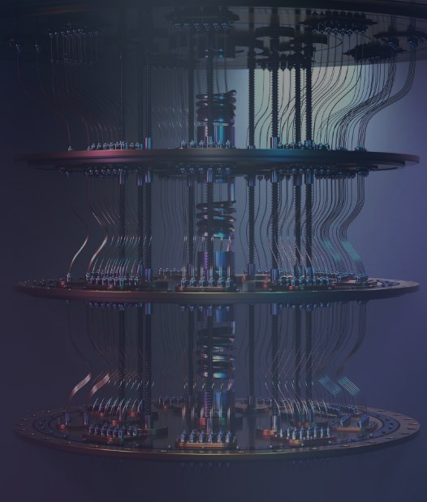
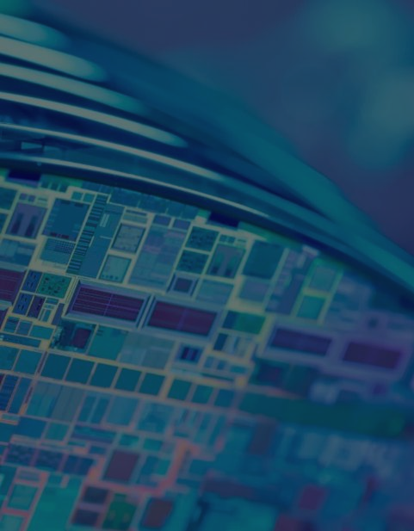

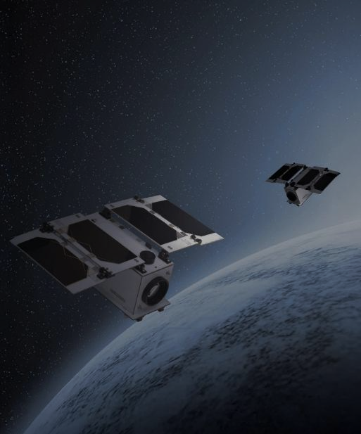
Major Strategic Initiatives
Post Quantum
Program
OSPT
Centers
Investment in Quantum & Tech Companies
Satellite
Connectivity
High-performance chip design & customization centers in EU (starting 25), UAE (signed), INDIA
35M$ Fund to invest in Quantum & Tech companies
(2 investments completed)
Cost-effective IoT solutions for industrial applications
(Satellites launched in June)
Custom & off the shelf quantum resistant semiconductors Commercial launch in 2026
10
9

Slide 10
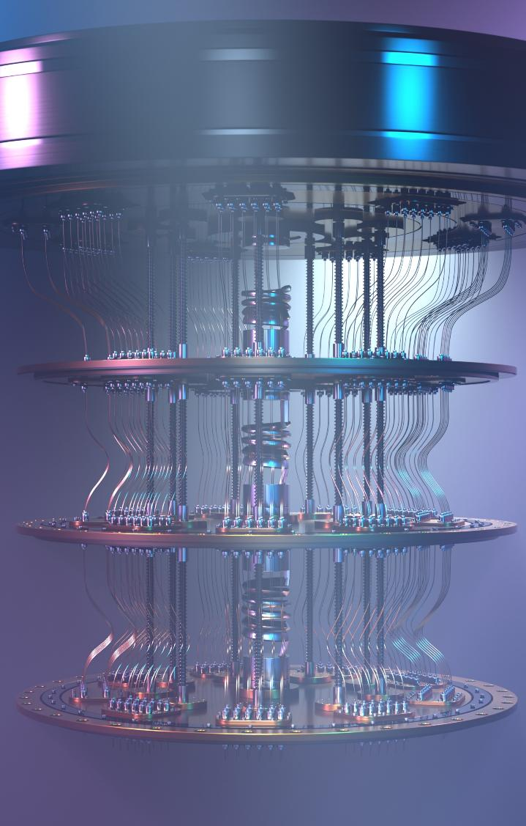




Highlight on SEALSQ’s Quantum Resistant Offer (QUASAR)
SEALSQ is pioneering the market with a Quantum Resistant suite offering the highest level of certifications
  Q1 2025: A Quantum Root-of-Trust
  Q2 2025: PKI services using NIST Post Quantum Cryptography
  Q4 2025: Quantum Resistant Semiconductors & security IP blocks to include in custom secure chips
Protection from logical & physical attacks
Platform Integrity (hardware & firmware )
Unique
& verifiable
System identity
Safeguard & manage cryptographic
keys & certificates
11

Slide 11

A Multi-Billion Unit Market
TPMs/ Secure elements/ HSMs/Secure ASICs embedding PQ algorithm
Quantum Resistant certificates (PKI)
2024 NIST Standards
2026 Mass Deployment
2030 ubiquitous PQ Chips/PKI
12
Source: Industry projections, NIST 2024 standards, xAI analysis (2025)

Slide 12
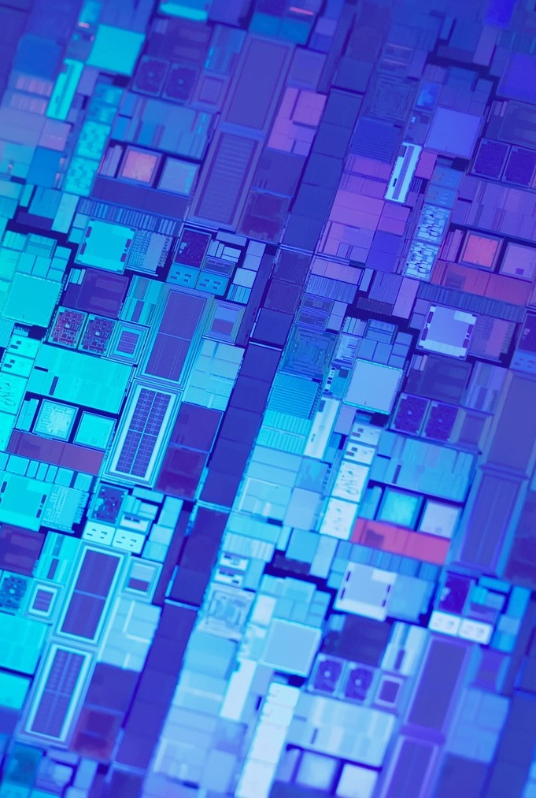
Dive-in: Test & Personalization centers
Full-stack Semiconductor Provisioning & Test centers
  Trust Center for generation of digital identities (keys & certificates)
  Wafer Testing & Final Test
  Data Injection & Secure Personalization
Projects:
  Signed & starting 2025: EU (Murcia, Spain) - SEALSQ/ODINS/SETT Joint Venture (€40M)
  Signed: UAE (Abu-Dhabi) – SEALSQ/AJYAL Joint Venture ($100M)
  In progress: INDIA, US.
Government-Backed Investments
  19.6m€ from Spanish Government via SETT
  100 m$ from UAE through AJYAL
Immediate Revenue for SEALSQ
  Professional Services charged from year 1
  IP Licensing model as recurring revenue
13

Slide 13


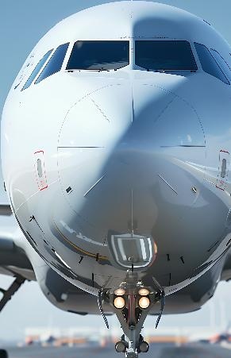




IC’ALPS Acquisition Strengthens ASIC capabilities
90+ experts in 2 R&D centers focusing on ASIC/SoC Design & Supply
EU leader on demanding markets: medtech (incl. ultrasound), automotive & security
EU / French sovereignty for sensitive apps (Defense, Healthcare, Gov)
Listed as recommended design partner by major foundries (TSMC, Intel, Xfab, OSRAM, GF)
Covers all technologies: Analog / Digital / Mixed-signal down to 1,8 nm
Strong synergies: Customer portfolio / Supply Chain/ Secure ASICS / Security IPs
Security
Healthcare
Mil/Aero
Environmental
Automotive
Industry 4.0
IoT/AI
14

Slide 14
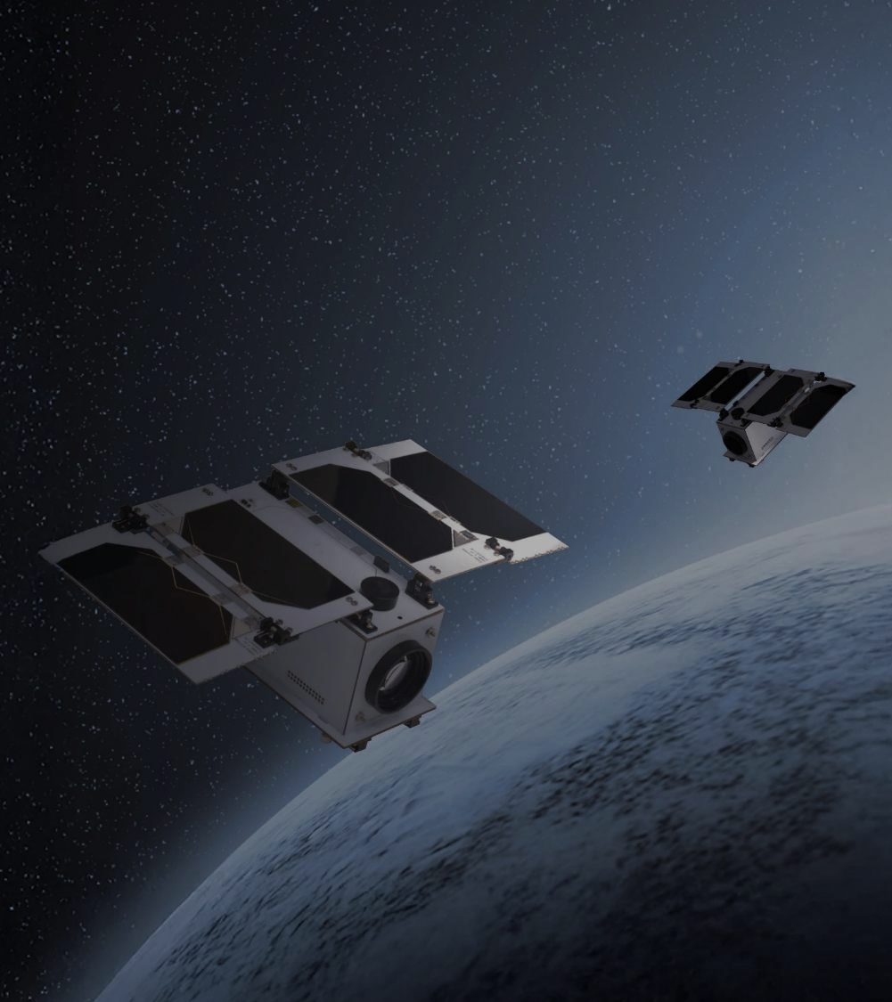
Dive-in: Secure Satellite Connectivity
Current Problem
Costly connectivity gap for a growing number of connected devices.
~80% Terrestrial connectivity gap
+25B IoT connected devices (2030)
Costly, Inefficient & Complex
Current solutions
Solution
Over 20 new next-generation satellites launched.
& More to come…
Each satellite will feature incremental advancements in post-quantum cryptography and secure communication technologies.
15

Slide 15
Financial Overview
Strong growth forecast for FY 2025 driven by:
strong return to growth in the demand for our current generation products
consolidated revenue of IC’ALPS since the completion of the acquisition
Initial revenues from the Quantix Edge project.
As expected, 2024 was a transitional year given:
Excess inventories at legacy customers
Customers and prospects awaiting availability of next-generation chips
Impact of global economic slowdown
The Company is well positioned to capitalize on pre-shortage demand from legacy customers and new business opportunities, expected to materialize in 2025.
  $16.0-20.0M
  Forecast Revenue
  FY 2025
  Growth of 45% – 82%
  $120M
  cash reserve
  at June 30, 2025
  $145M pipeline
  New Revenue Opportunities from 2026-2028
  $5M
  R&D Investments
  In FY 2024
  $7.2M planned for FY 2025
16

Slide 16
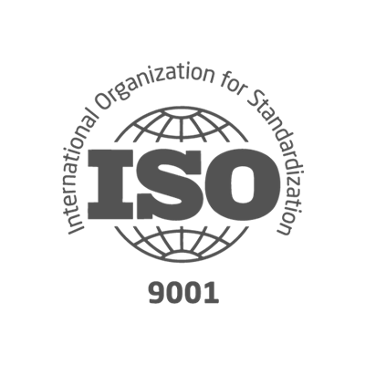
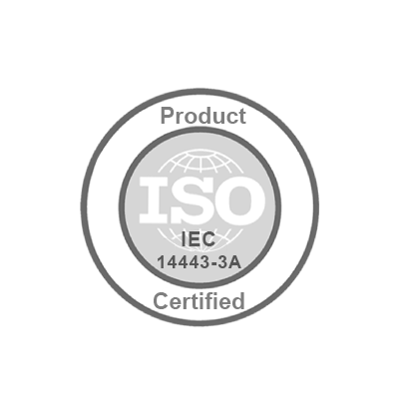




Key Figures
SEALSQ Corp.
Established | 1998 (acquired by WISeKey, parent company of SEALSQ in 2016 and reorganized in 2022)
Headquarters | France
Employees | ~175 total
 | ~75 R&D focused
Client base | 30+ countries
Patents | 118 security related
Certifications
Data as of June 2025
Nasdaq listed | May 2023
Ticker symbol | LAES
Shares Outstanding
Ordinary Shares | 139.6 Million**
F shares * | 1,499,800
Stock price | $2.55/share
Market cap | $356 million
* In terms of dividend rights, 1 F share is equivalent to 5 Ordinary shares ** Data as of June 11, 2025
SEALSQ designs, produces and sells
Semiconductors, PKI Services and Post-Quantum technology products
5

Slide 17
Contact Us
Investor Relations (US)
The Equity Group Inc.
Lena Cati
Tel: +1 212 836-9611
lcati@equityny.com
SEALSQ Corp.
Carlos Moreira
Chairman & CEO
info@sealsq.com

Slide 18
2025 Outlook
  Bookings +80%
  vs. same time in prior year
  $93M pipeline
  Potential contracts
  OSPT projects
  2 projects signed in 2025
  >80 active engagements
  On new post-quantum TPM product opportunities
17

